Slide 1

YouTube Trending Videos
By Group – 3
Achal Hemal Doshi
Vamsi Kanamarla Puti
Mohammed Affan Ahmed
P Manikanta Manohar

Slide 2
Index
SLIDE NUMBERS | CONTENT
3 | ABSTRACT
4 | INTRODUCTION, OBJECTIVE, AND TECHNICAL APPROACH
5 | DATA
6 | DROPPING THE DISLIKES COLUMN
7, 8, 9 | SCATTER PLOTS
10 | APPLYING REGRESSION
11, 12 | APPLYING MODEL
13, 14 | CONCLUSION AND APPENDIX

Slide 3
Abstract
YouTube is a popular platform for sharing and watching videos, offering a diverse selection of content for users to enjoy.
The “Trending” section on YouTube displays the most popular videos at any given time, providing valuable insights into contemporary digital culture for content creators, marketers, and researchers alike.
This study delves into the characteristics, patterns, and factors that contribute to the viral nature of trending videos on YouTube.
As a massive digital entity, YouTube draws in audiences from all over the world with its vast collection of videos covering almost every topic imaginable.
Within this platform lies the “Trending” tab, a virtual hotpot that showcases a dynamic mix of videos that have captured the collective attention of millions.
This section not only reflects popular culture but also the changing landscape of user preferences and trends.
The idea of trending videos on YouTube is a fascinating phenomenon, where videos - regardless of their genre, length, or origin - can quickly rise to the forefront of viewer consciousness.

Slide 4
Introduction, Objective, and Technical Approach
YouTube is a popular video platform that provides trending video lists.
Analyzing these videos can give content creators valuable insights to improve their channel branding.
Businesses can use this analysis to boost their growth by publishing videos or sponsoring appropriate channels.
This paper assists readers in finding, measuring, analyzing, and comparing key aspects of trending videos on YouTube.
The objective of the project is, to analyze the popularity of YouTube videos.
Python Concepts such as Pandas, NumPy, Seaborn, and Matplotlib.
Machine Learning Concepts such as Linear Regression, and Lasso and Ridge Regression.

Slide 5
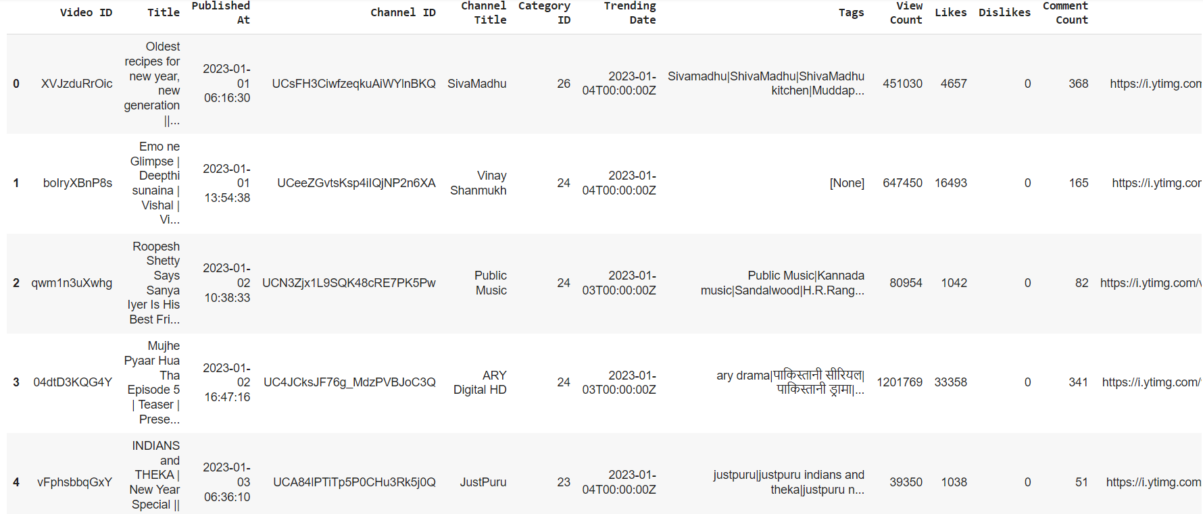
Data
The data of YouTube Trending Videos has 16 attributes.
The variable describes the features of YouTube Trending Videos. Ex: Video ID, Title, Published At, etc.
There are 118 instances.

Slide 6
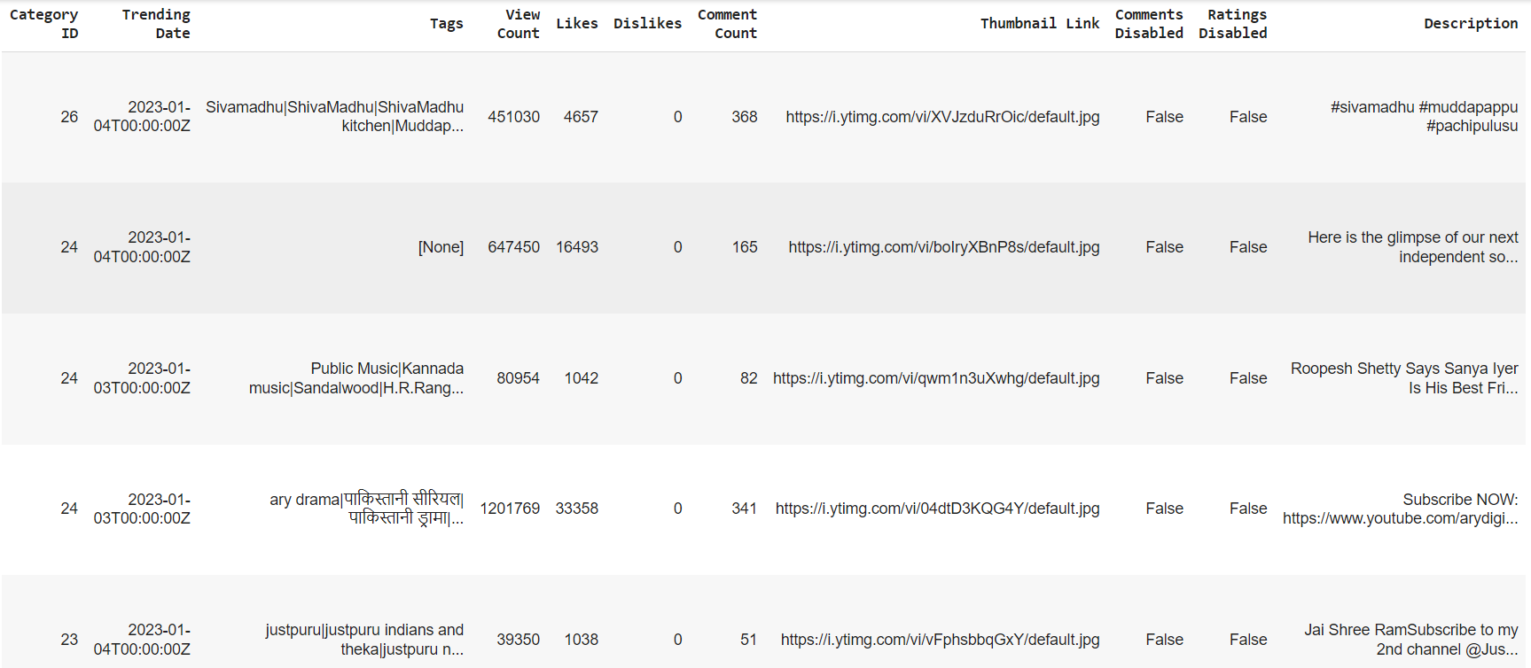
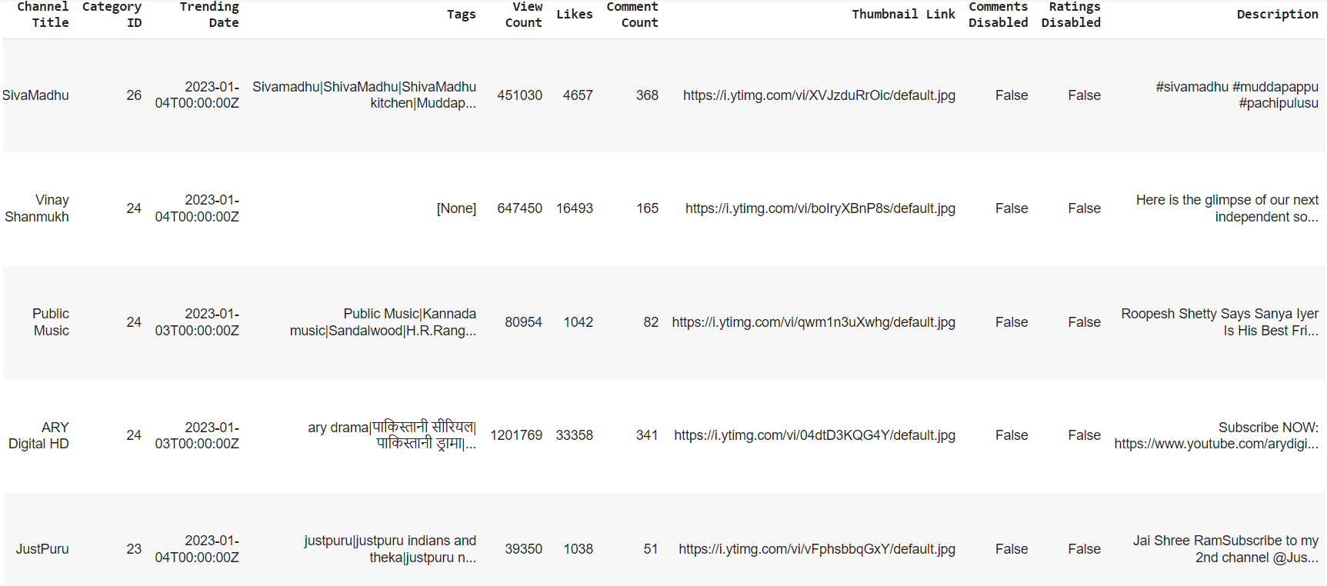
Dropping the Dislikes Column
Given that dislikes have only one unique value, the column is deemed unnecessary and can be removed or deleted.

Slide 7
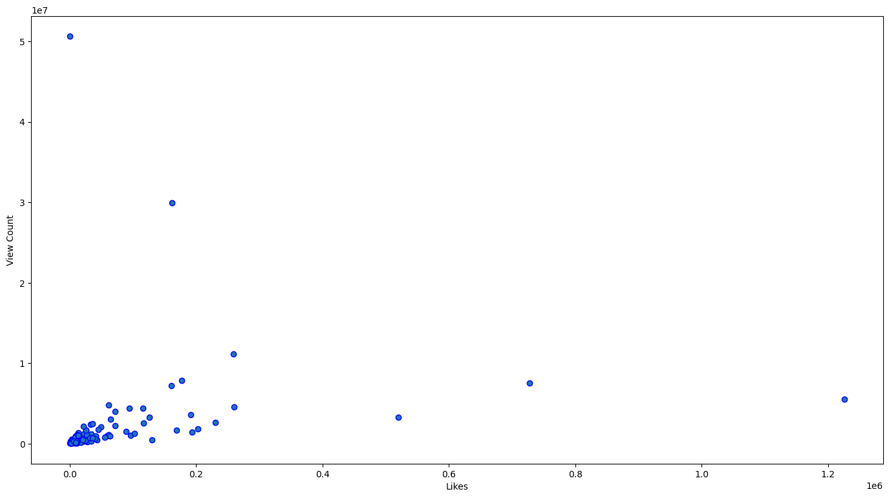
Scatter Plots
Scatter Plot of Views and Likes

Slide 8
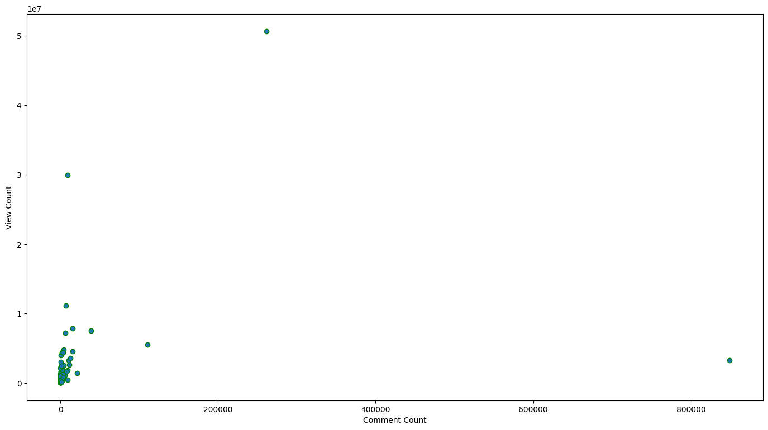
Scatter Plots
Scatter Plot of Views and Comments

Slide 9
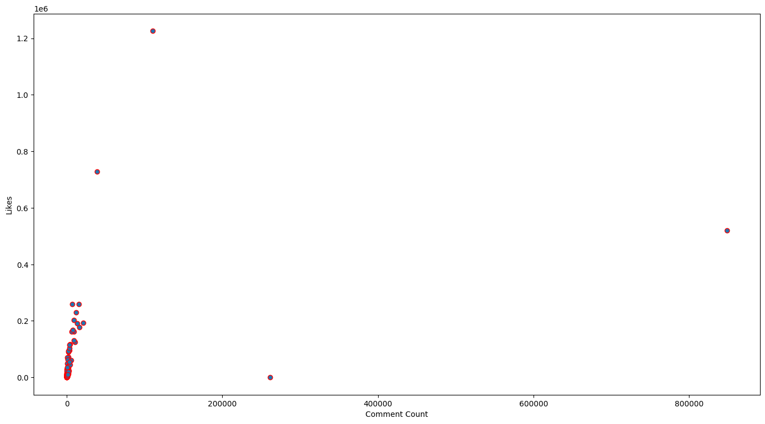
Scatter Plots
Scatter Plot of Likes and Comments

Slide 10
Applying Regression
Dividing Independent and Dependent Variables
Before model building, segregate the dataset into independent (stored in list x) and dependent variables (stored in y), where x includes Likes, and Comment Count, while y is View Count.
Splitting the Data
To split the training and testing parts, we can use the scikit-learn module train_test_split.
Feature Scaling
We do the scaling of the data for balancing the data points.

Slide 11

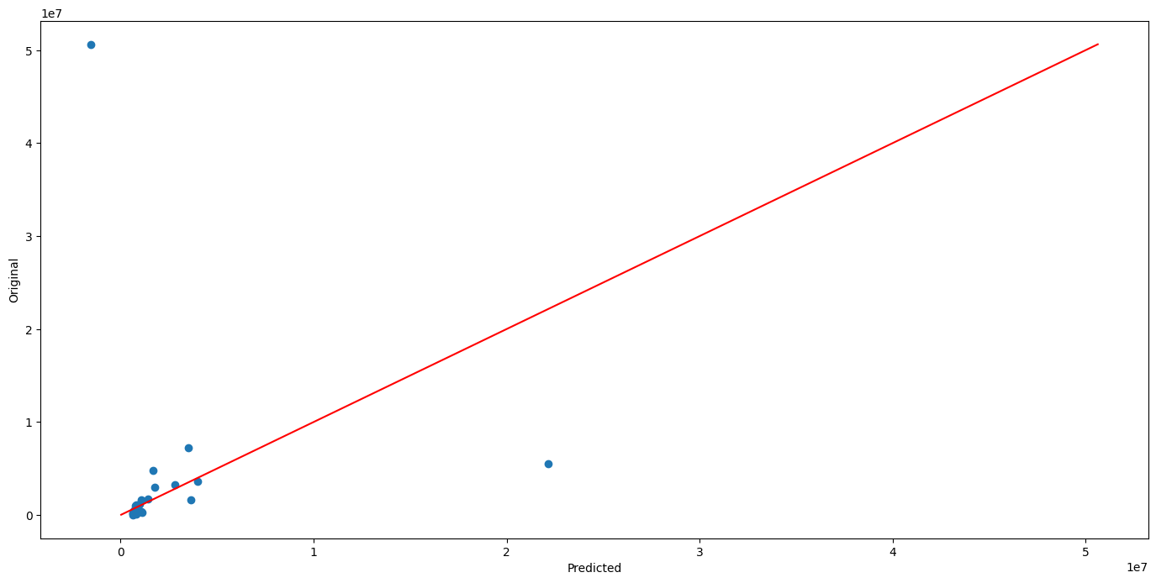
Applying Model
Linear Regression
Plot of Linear Regression

Slide 12
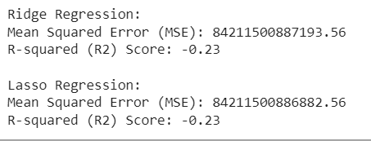
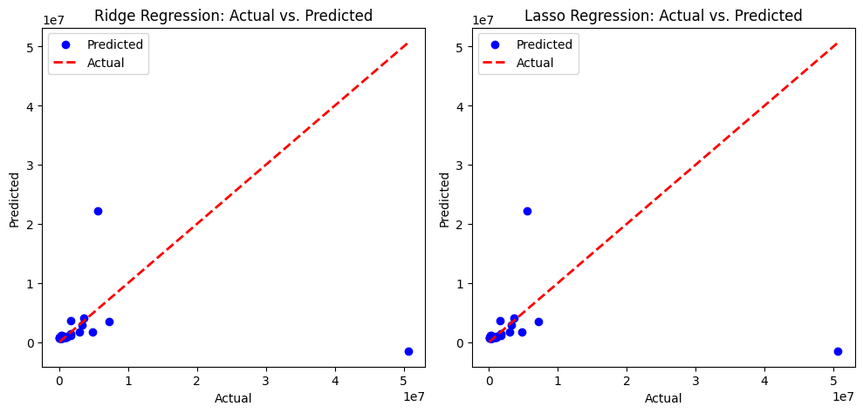
Applying Model
Ridge and Lasso Regression
Plot of Ridge and Lasso Regression

Slide 13
Conclusion
We analyzed YouTube Trending Videos and found that likes and comments have a positive correlation with views.
We used machine learning models to predict view counts and found Ridge Regression to be the most accurate.
Our analysis has limitations, but content creators can use our findings to encourage engagement and improve visibility.
In the ever-changing world of online video, data analysis remains a valuable tool for understanding trends and optimizing content.

Slide 14


Thank You
Google Colab Link:
https://colab.research.google.com/drive/1QHMOOttmahZJulQd30i2PfaKEvT29ESN?usp=sharing
GitHub Link:

